Slide 1
PS DUPONT
EUROPEAN
TRIP
PARENT-STUDENT
MEETING
JUNE 2018

Slide 2
WHY ARE WE GOING?
1. Learning about local culture
2. Meeting new people and making new friends
3. Expanding students' world view

Slide 3
WHERE ARE WE GOING?

Slide 4
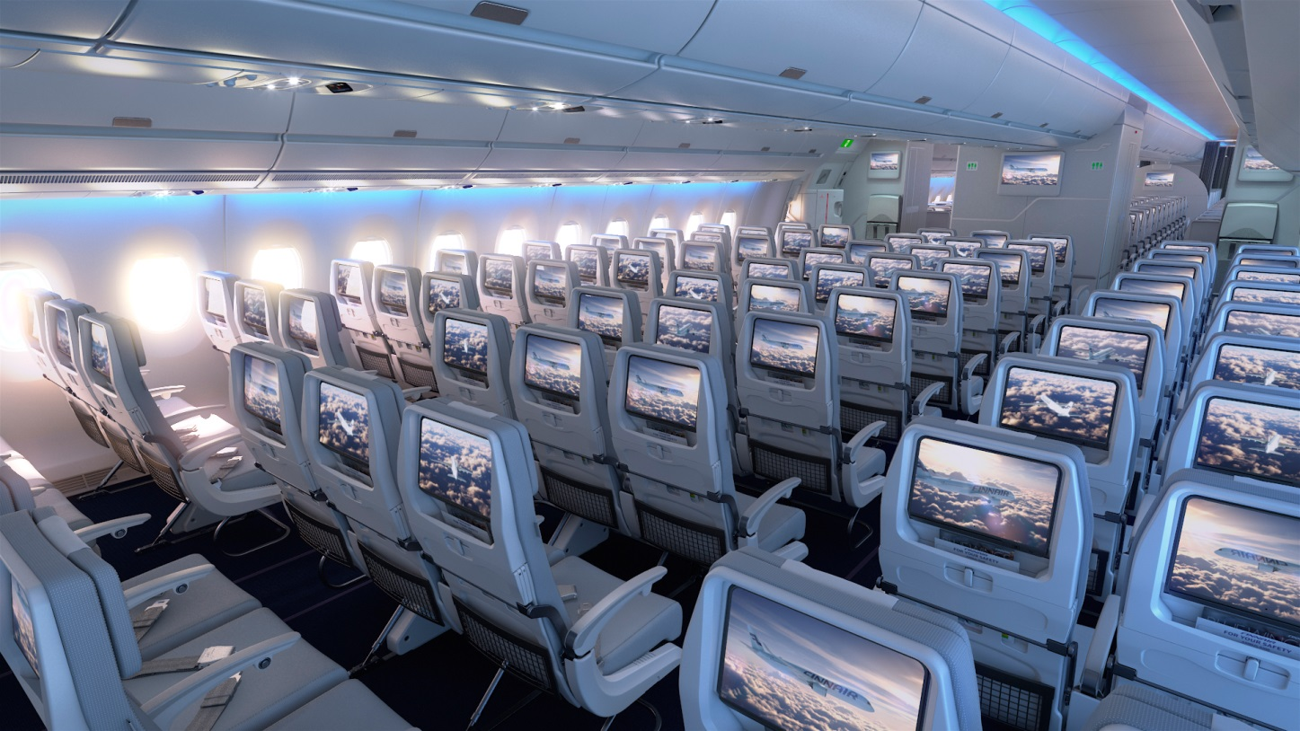
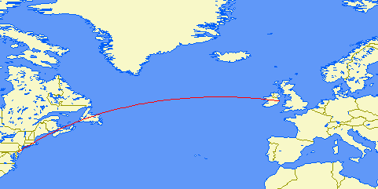
ROUNDTRIP
AIRFARE
PHILADELPHIA
TO
DUBLIN
BOEING 777

Slide 5
DUBLIN

Slide 6
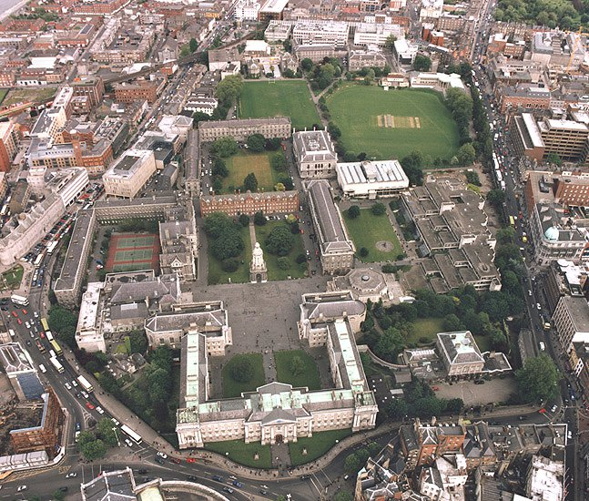
OUR HOUSING

Slide 7
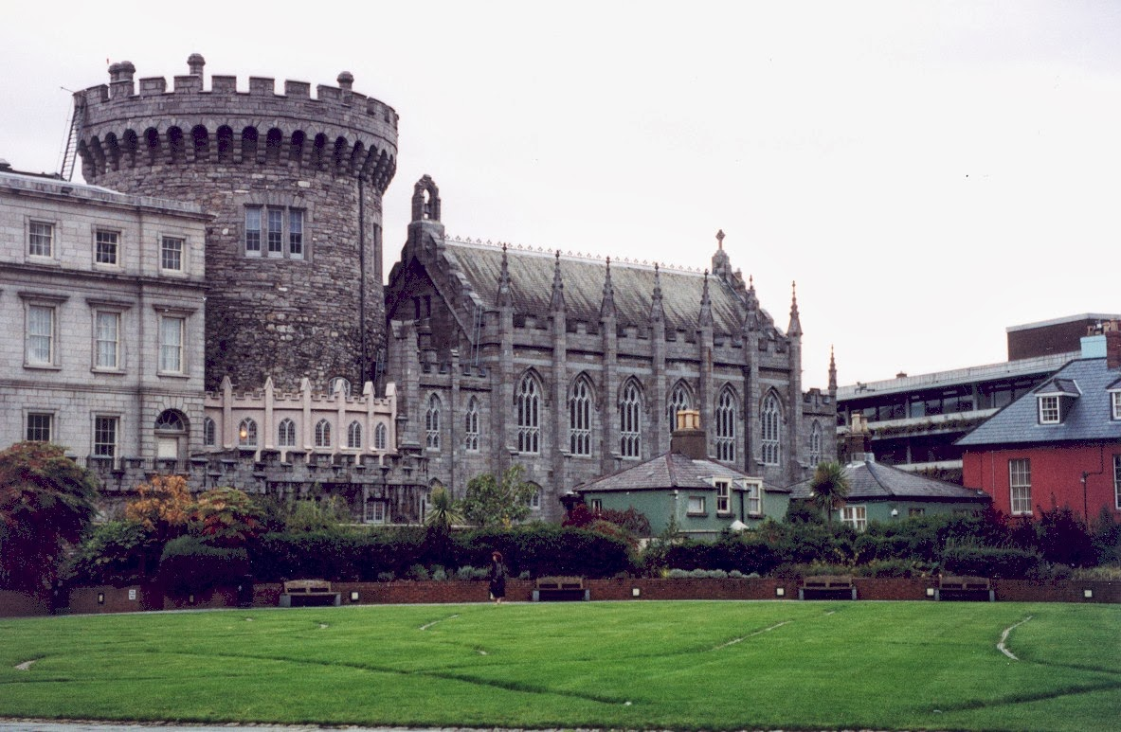
DUBLIN CASTLE

Slide 8
LONG ROOM AT TRINITY COLLEGE

Slide 9
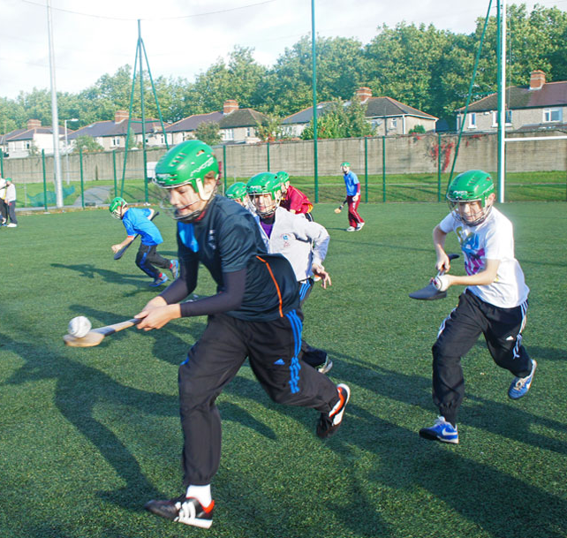
GAELIC GAMES TRAINING

Slide 10
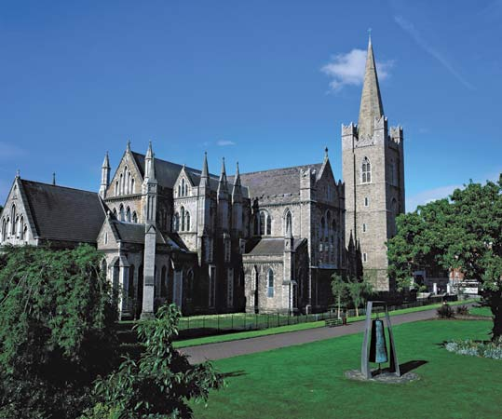
ST PATRICK’S CATHEDRAL

Slide 11
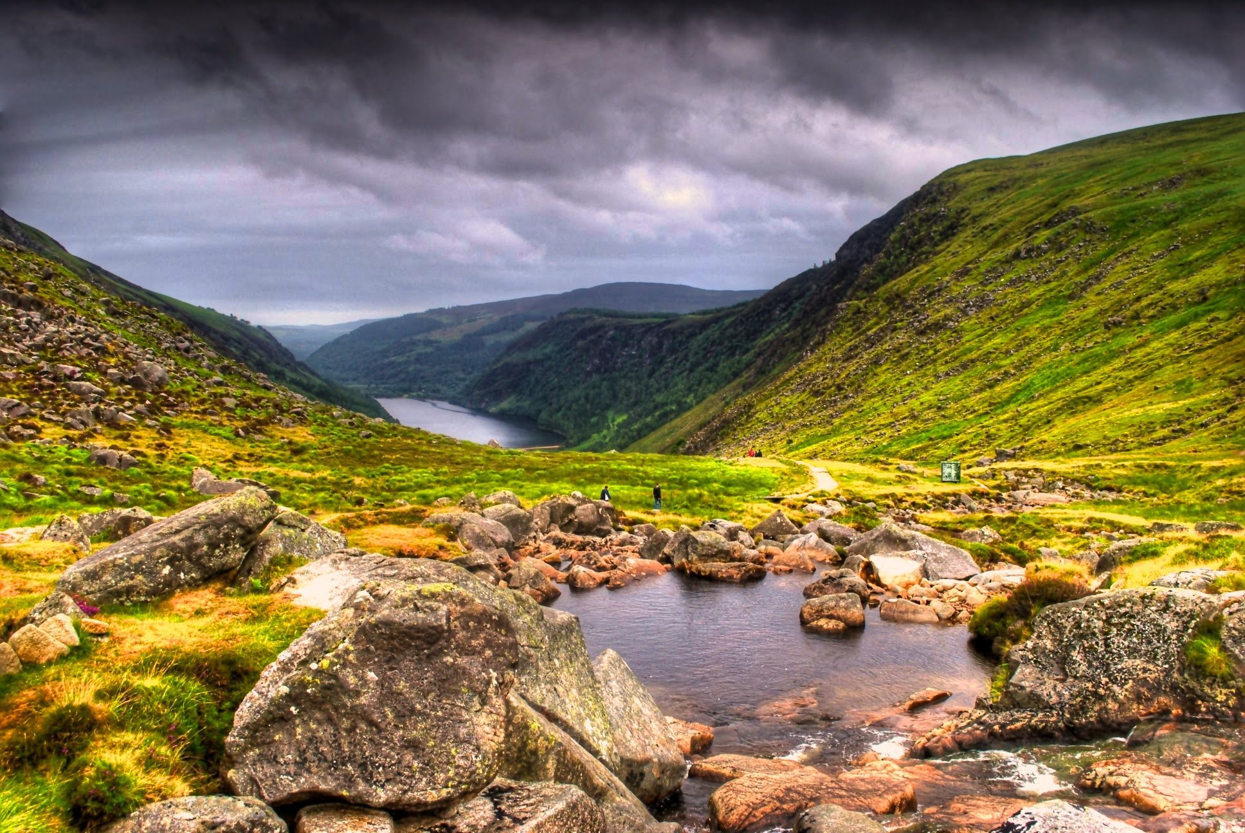
WICKLOW MOUNTAINS
THIS IS ONE OF TWO DAY TOURS INTO THE IRISH COUNTRYSIDE

Slide 12
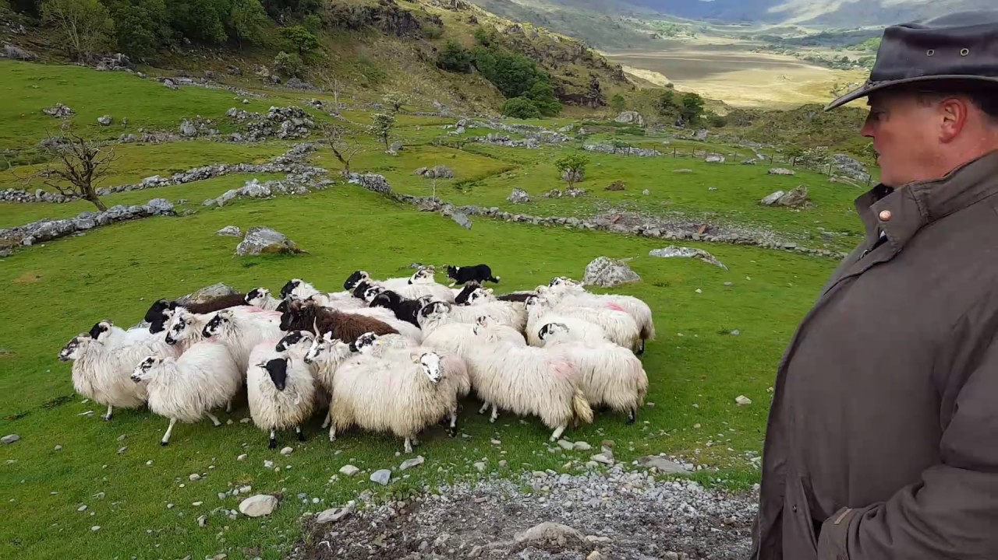
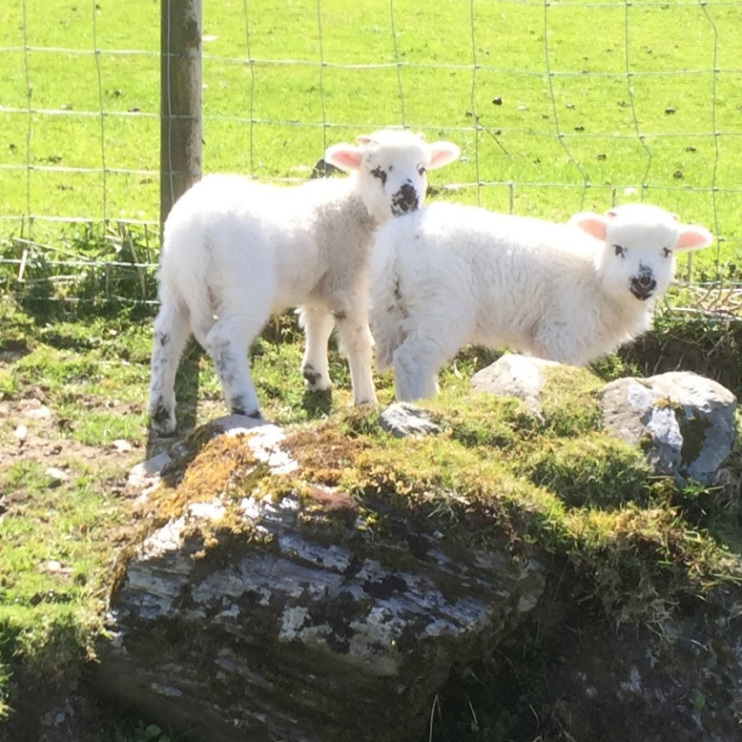
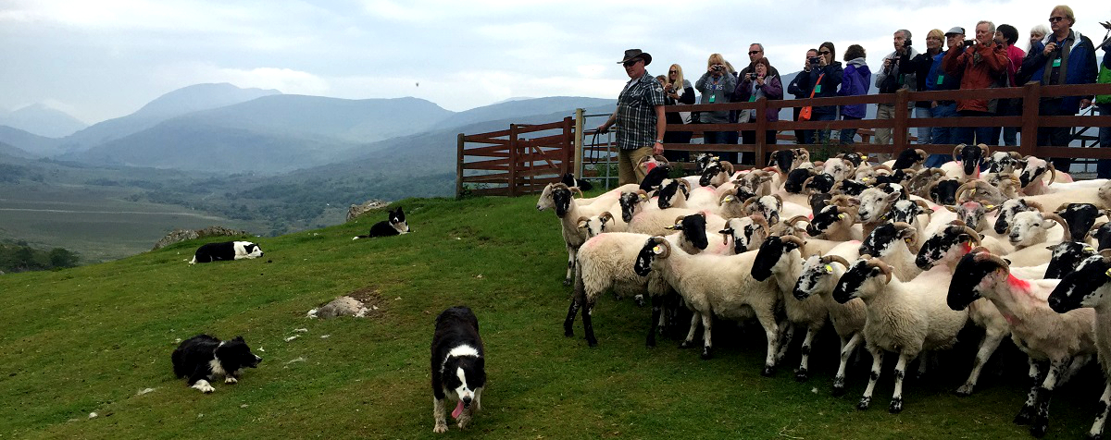
SHEEP FARM DEMONSTRATION
OUR STUDENTS WILL PARTICIPATE

Slide 13
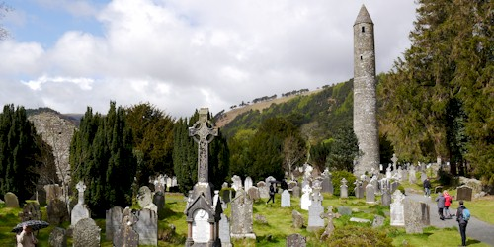
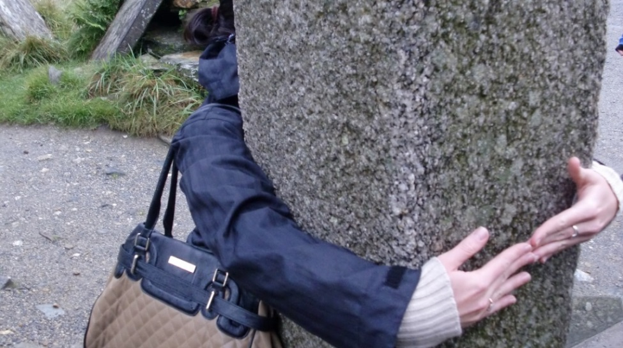
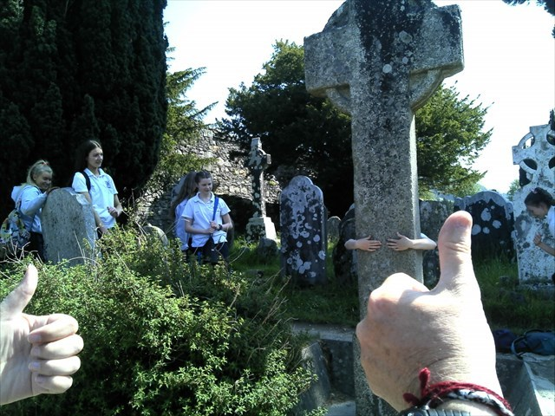
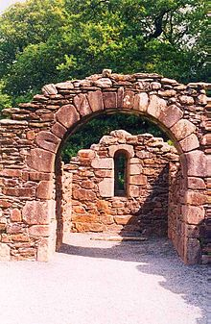
GLANDALOUGH MONASTERY
CELTIC LEGEND STATES IF YOU CAN GET YOUR ARMS AROUND THE ST KEVIN’S CROSS, YOUR WISHES WILL BE GRANTED!

Slide 14
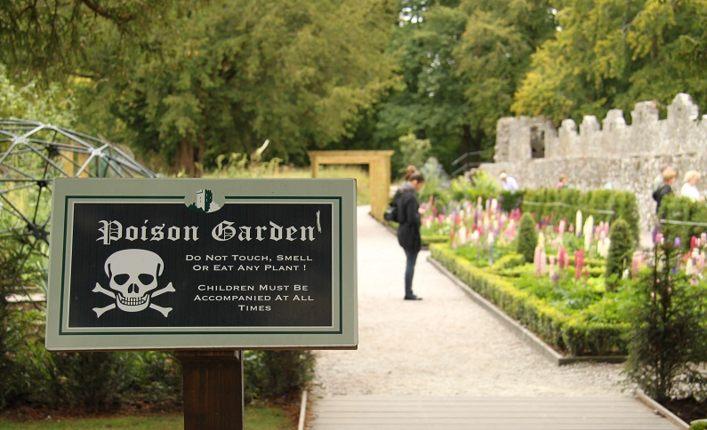
YES,
WE WILL HAVE THE CHANCE TO KISS THE BLARNEY STONE!

Slide 15
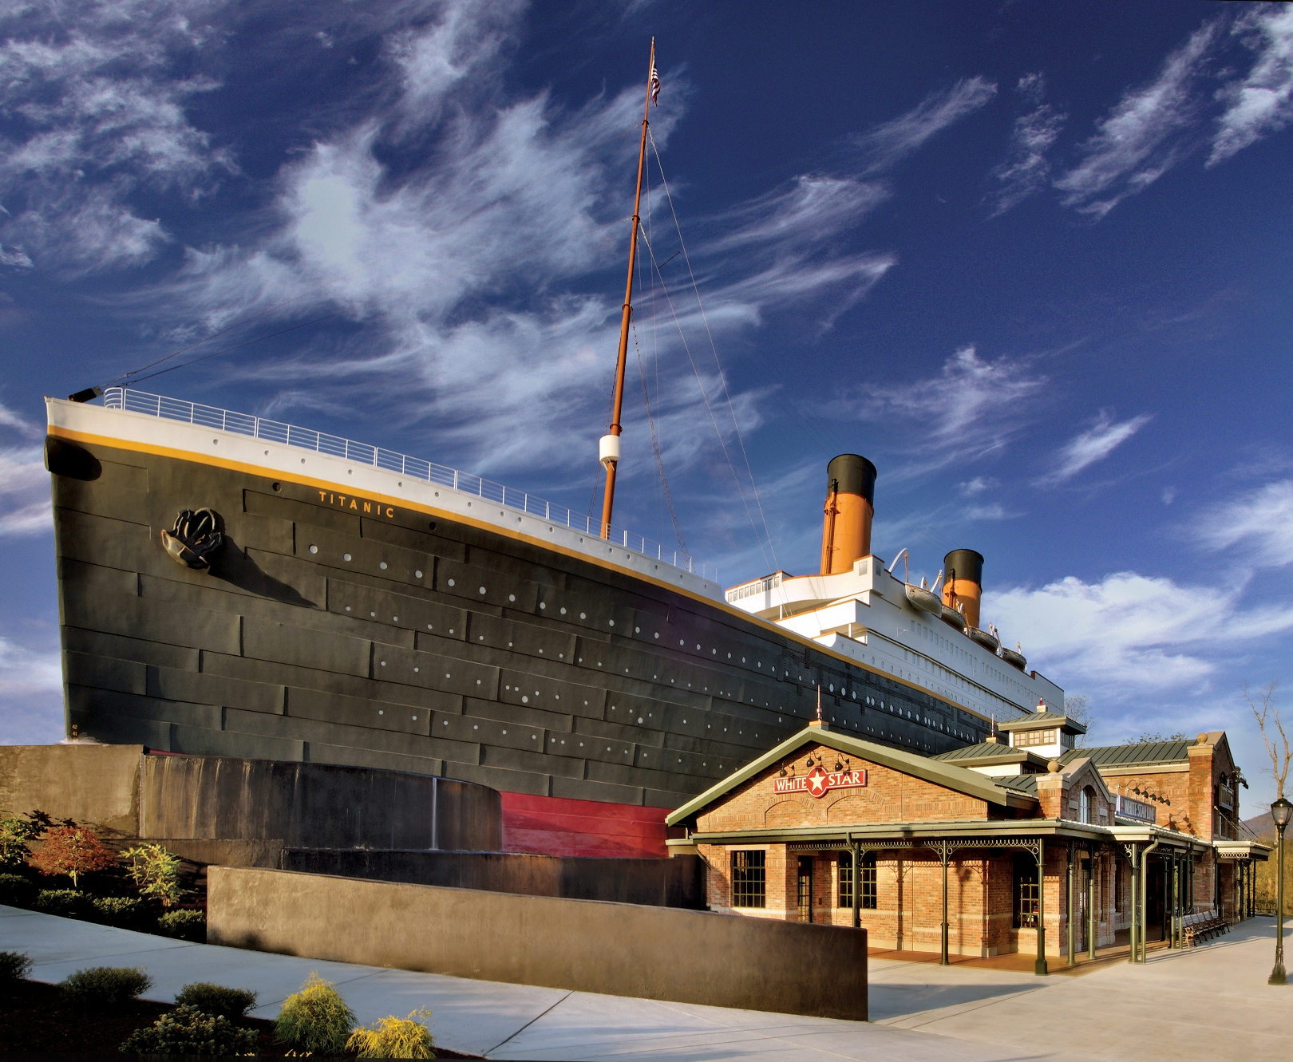
COBH, IRELAND
THE TITANIC EXHIBIT

Slide 16
EVENING ACTIVITIES

Slide 17
EVENING ACTIVITIES

Slide 18
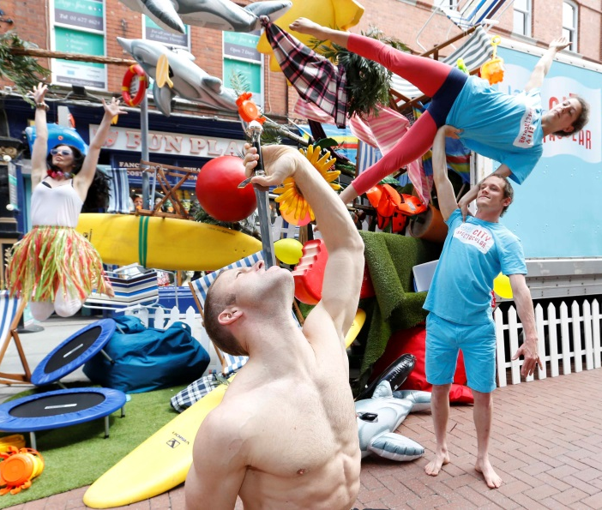
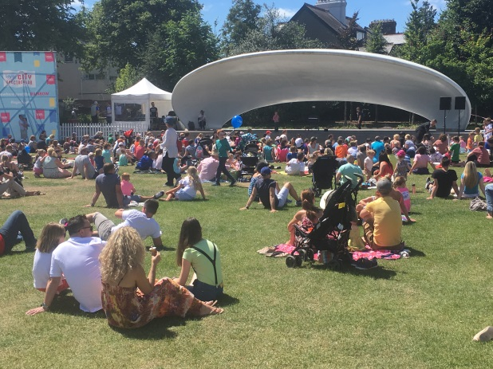
EVENING ACTIVITIES

Slide 19
TRAVEL ACROSS THE IRISH SEA ON THE WORLD’S LARGEST FERRY

Slide 21
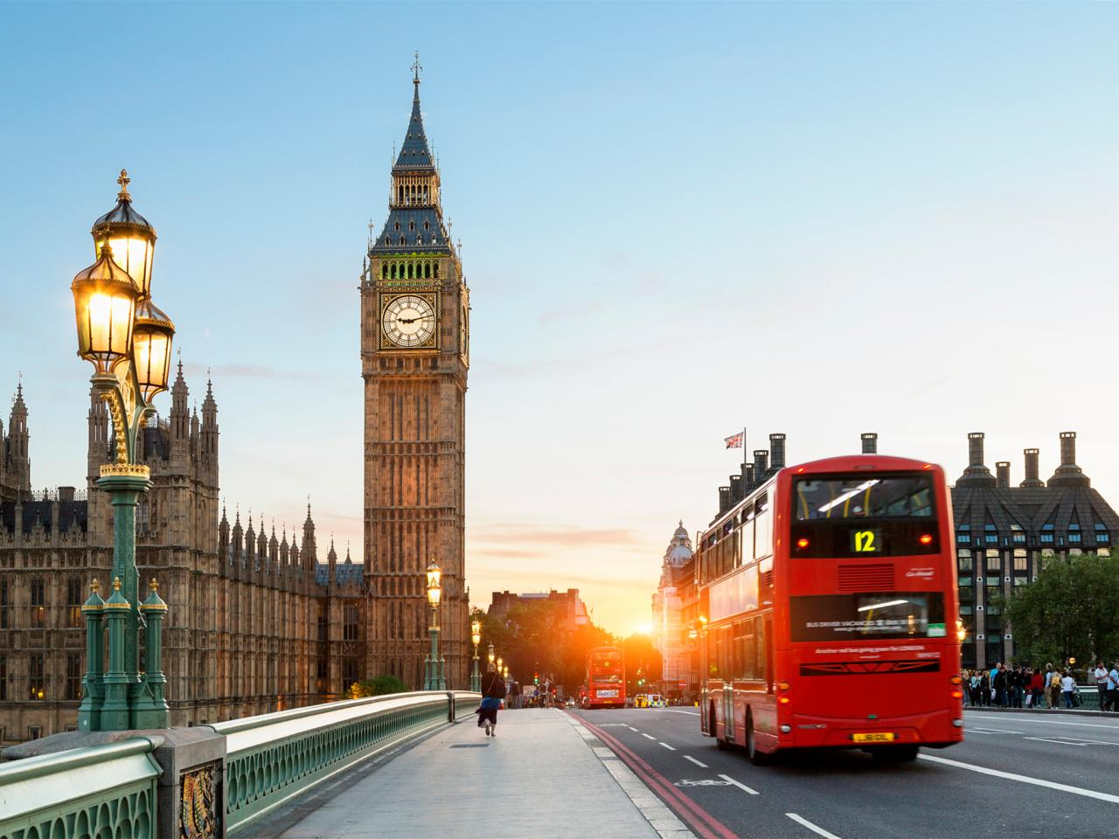
BIG BEN AND PARLIAMENT

Slide 22
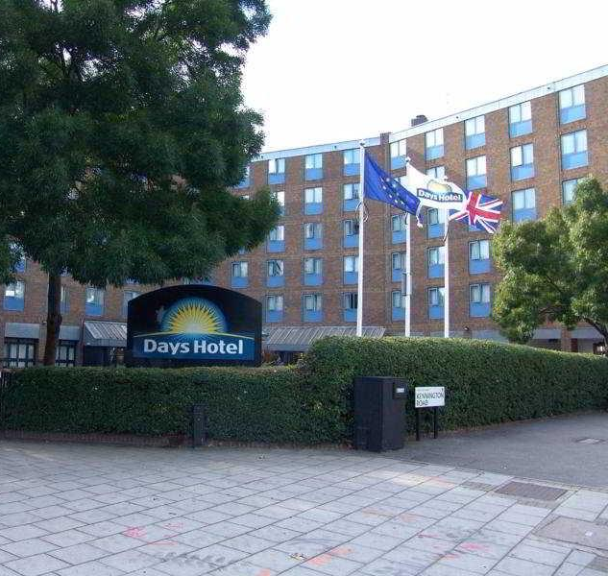
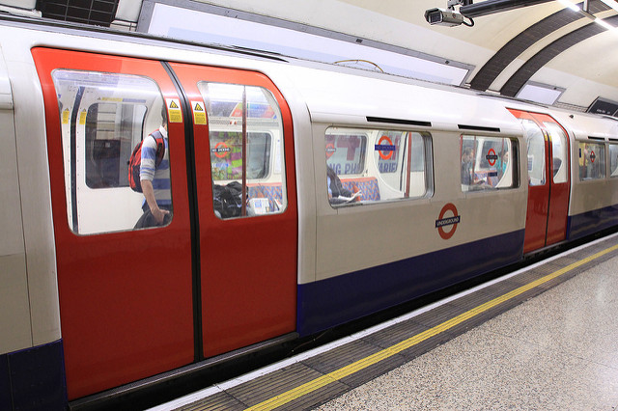
OUR LONDON HOTEL
LONDON’S UNDERGROUND
“THE TUBE”

Slide 23
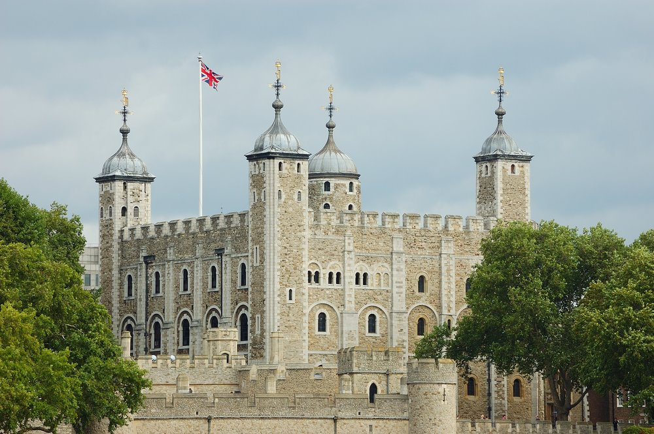
TOWER OF LONDON

Slide 24
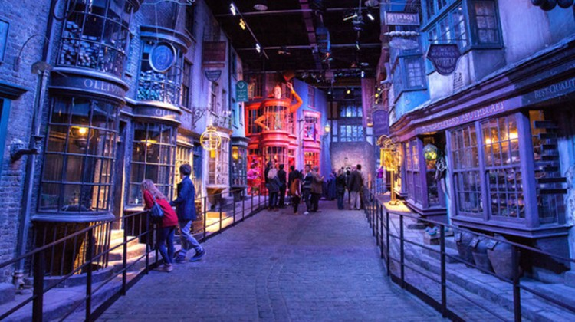
HARRY POTTER EXPERIENCE

Slide 25
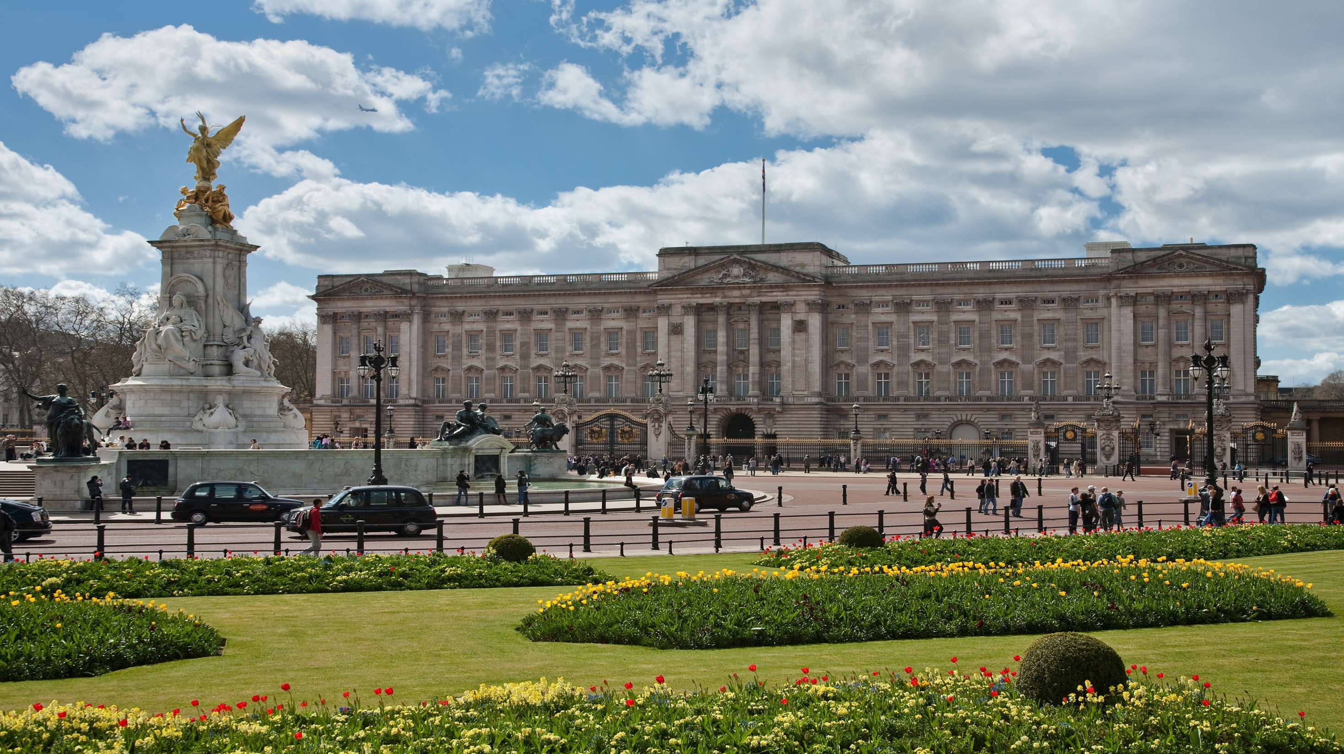
BUCKINGHAM PALACE

Slide 26
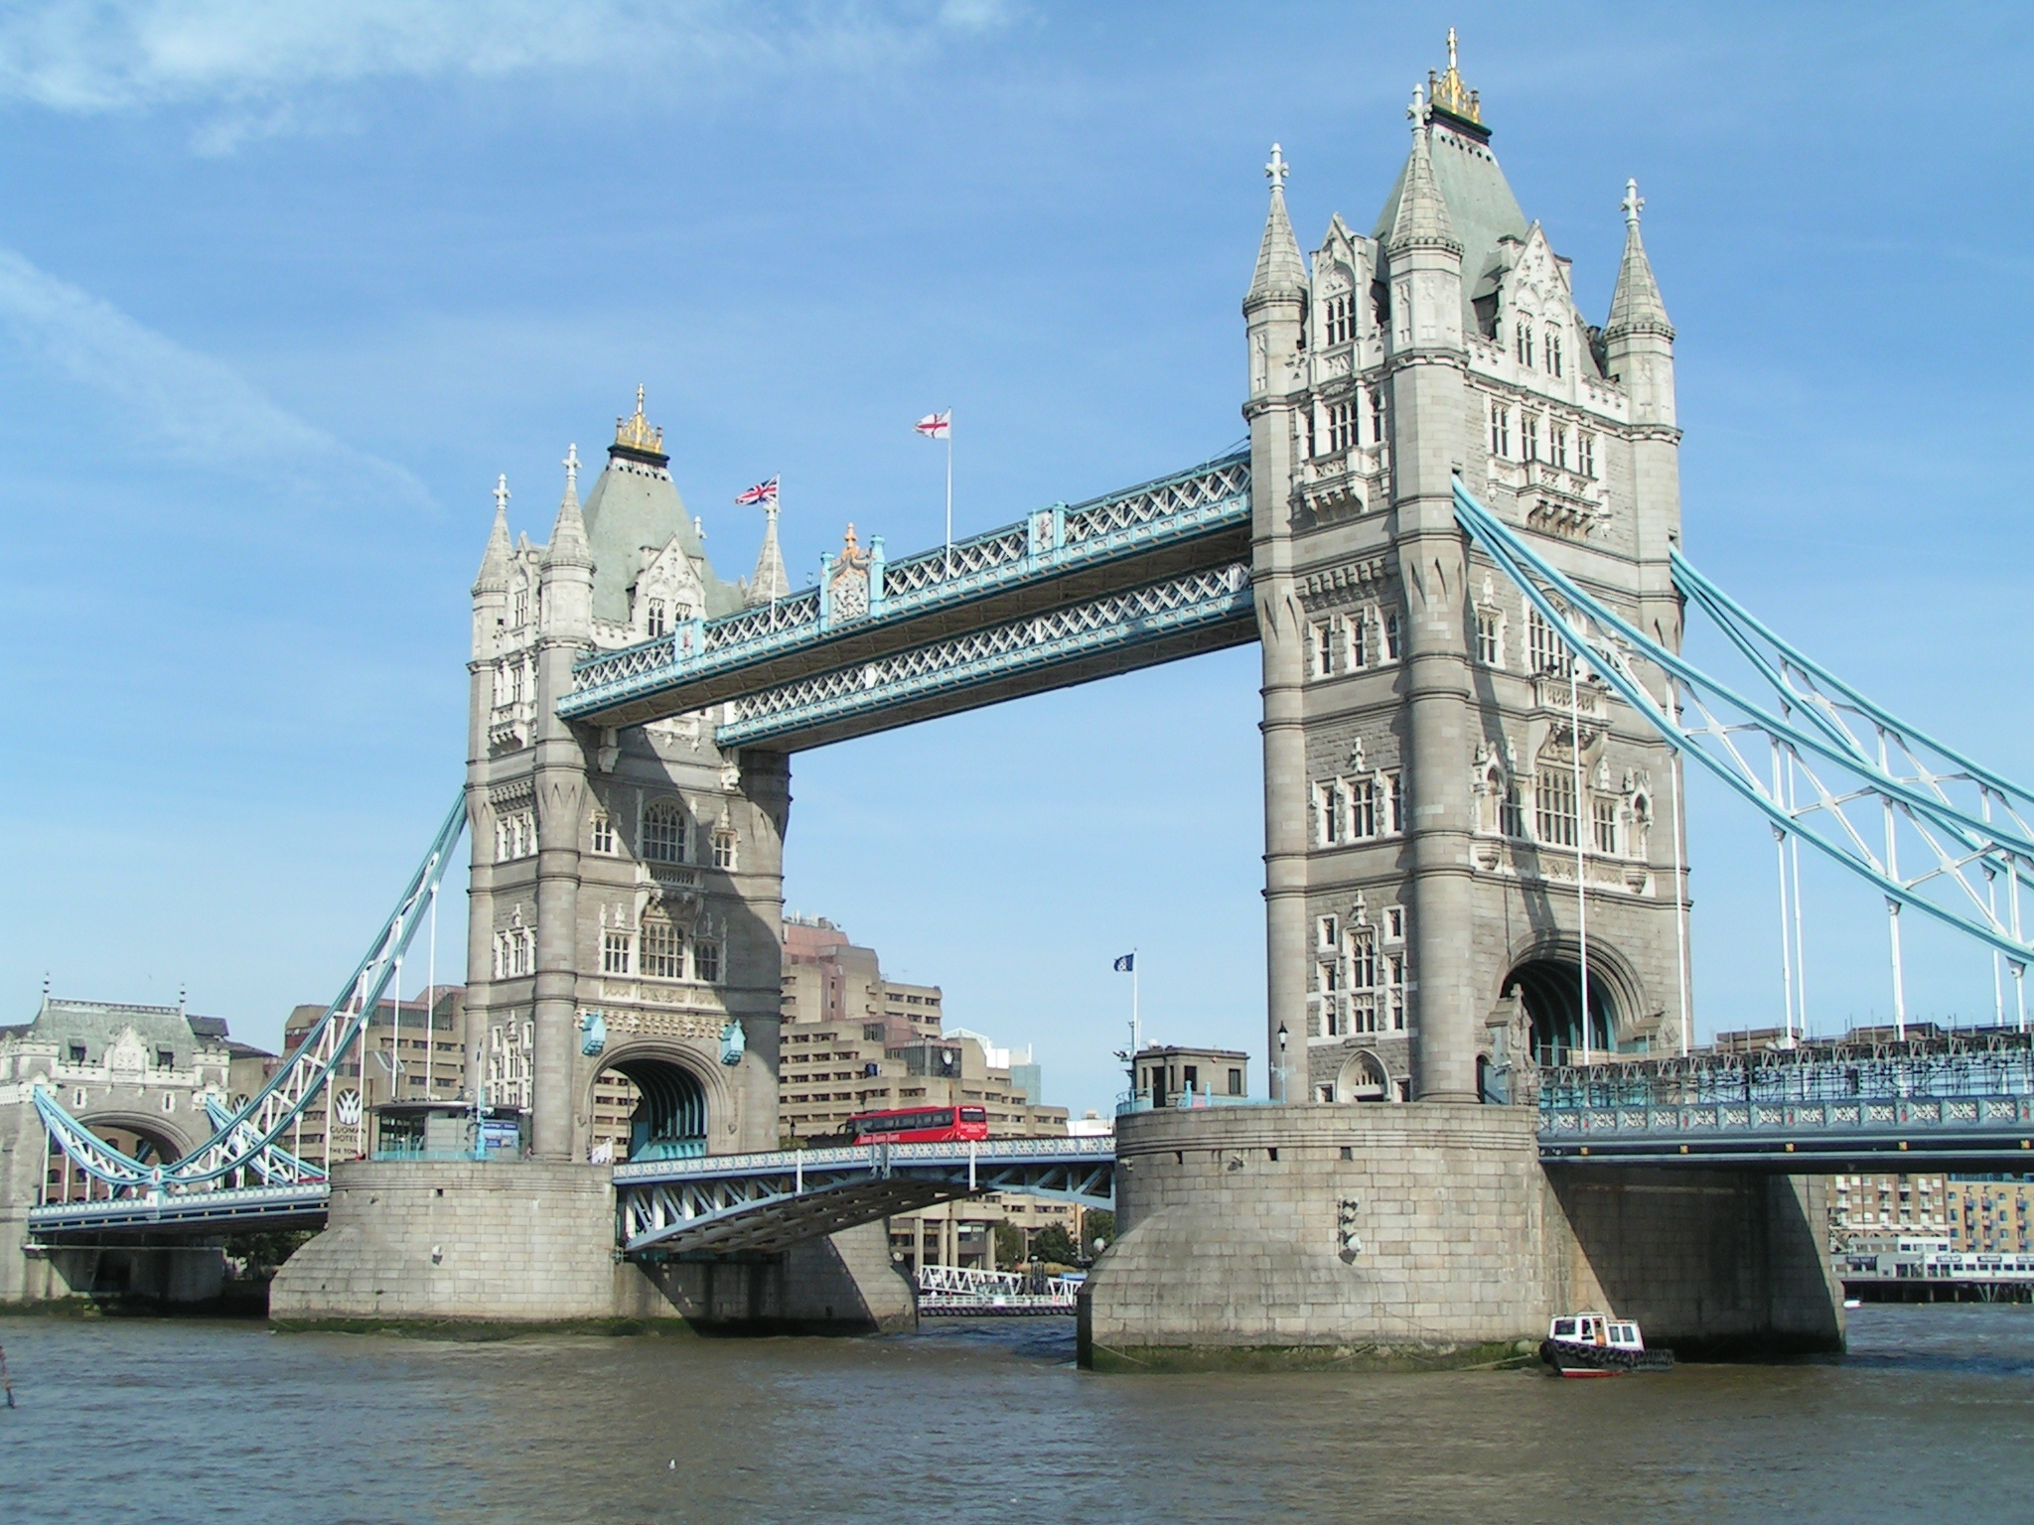
TOWER BRIDGE OF LONDON

Slide 27
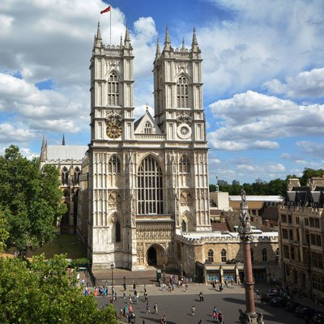
WESTMINSTER
ABBEY

Slide 28
THE SHARD OBSERVATORY

Slide 29
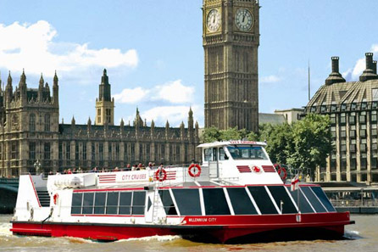
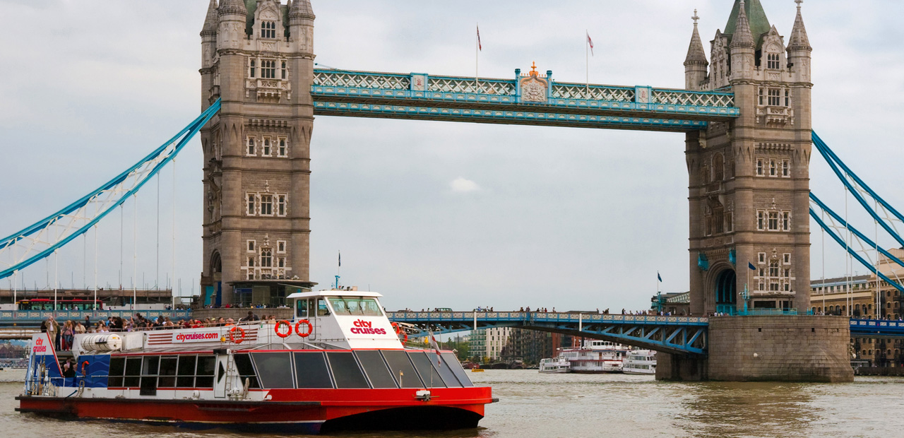
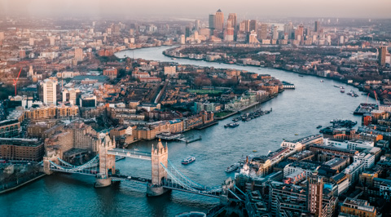
THAMES RIVER CRUISE

Slide 30
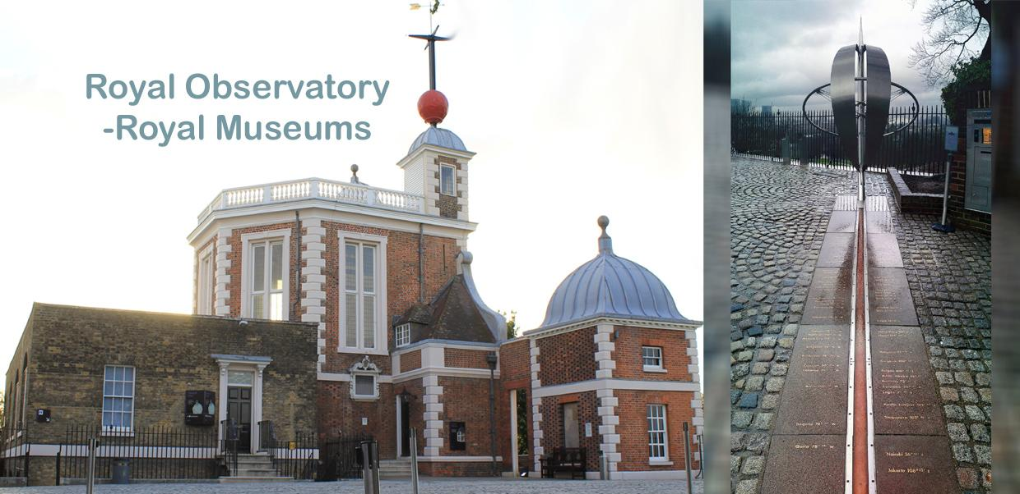
GREENWHICHRIVER CRUISE
STRADDLE THE PRIME MERIDIAN
BE IN TWO HEMESPHERS AT ONCE!

Slide 31
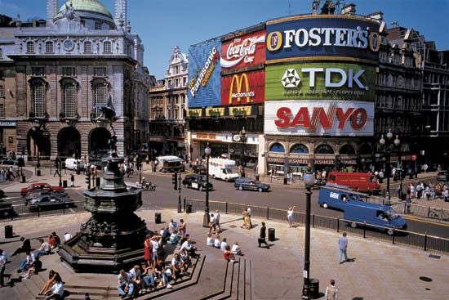
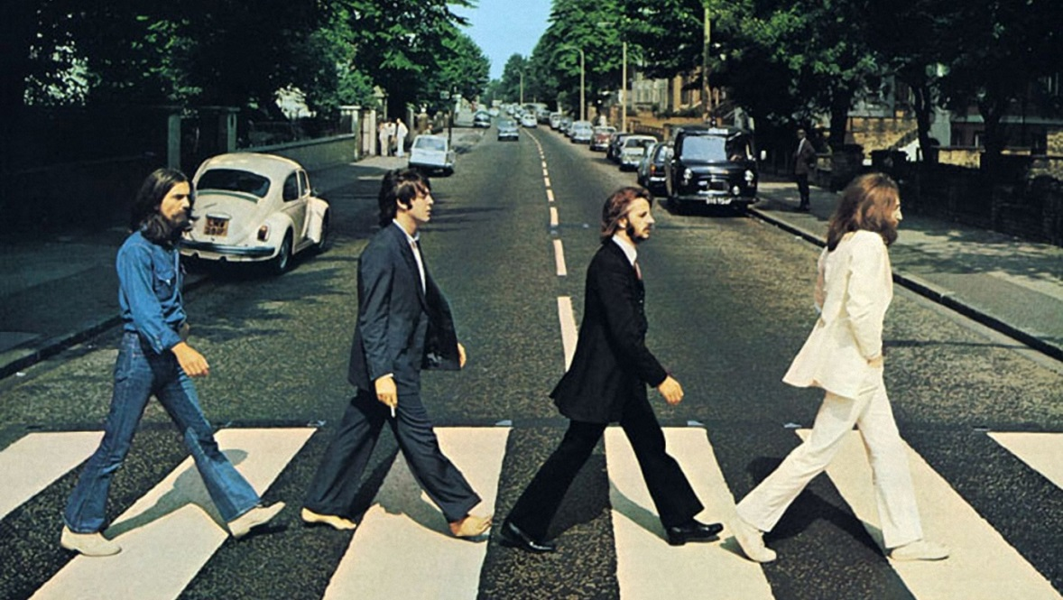
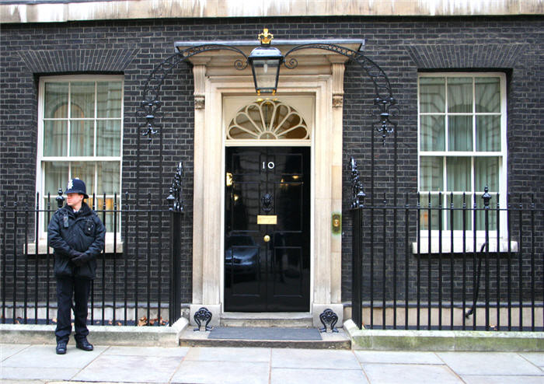
ICONIC LONDON ADDRESSES

Slide 32
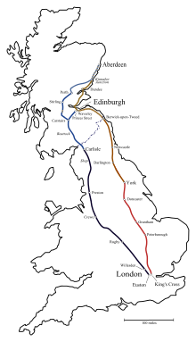
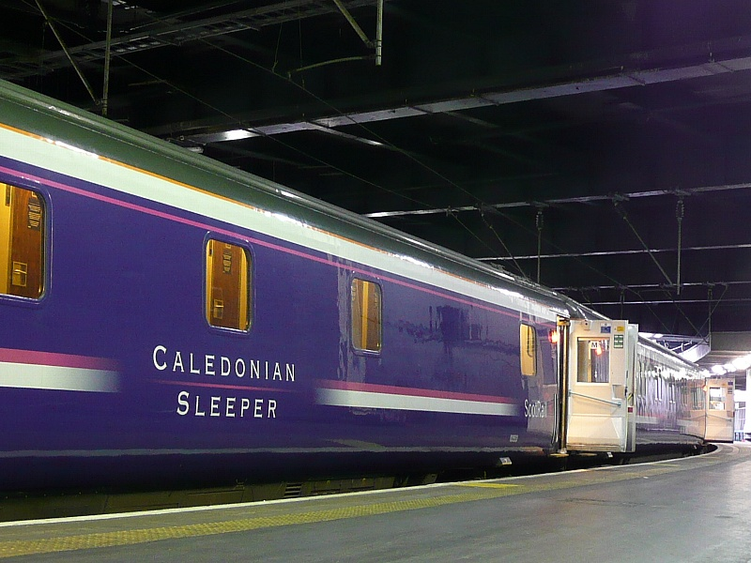
OVERNIGHT TRAVEL TO SCOTLAND

Slide 34
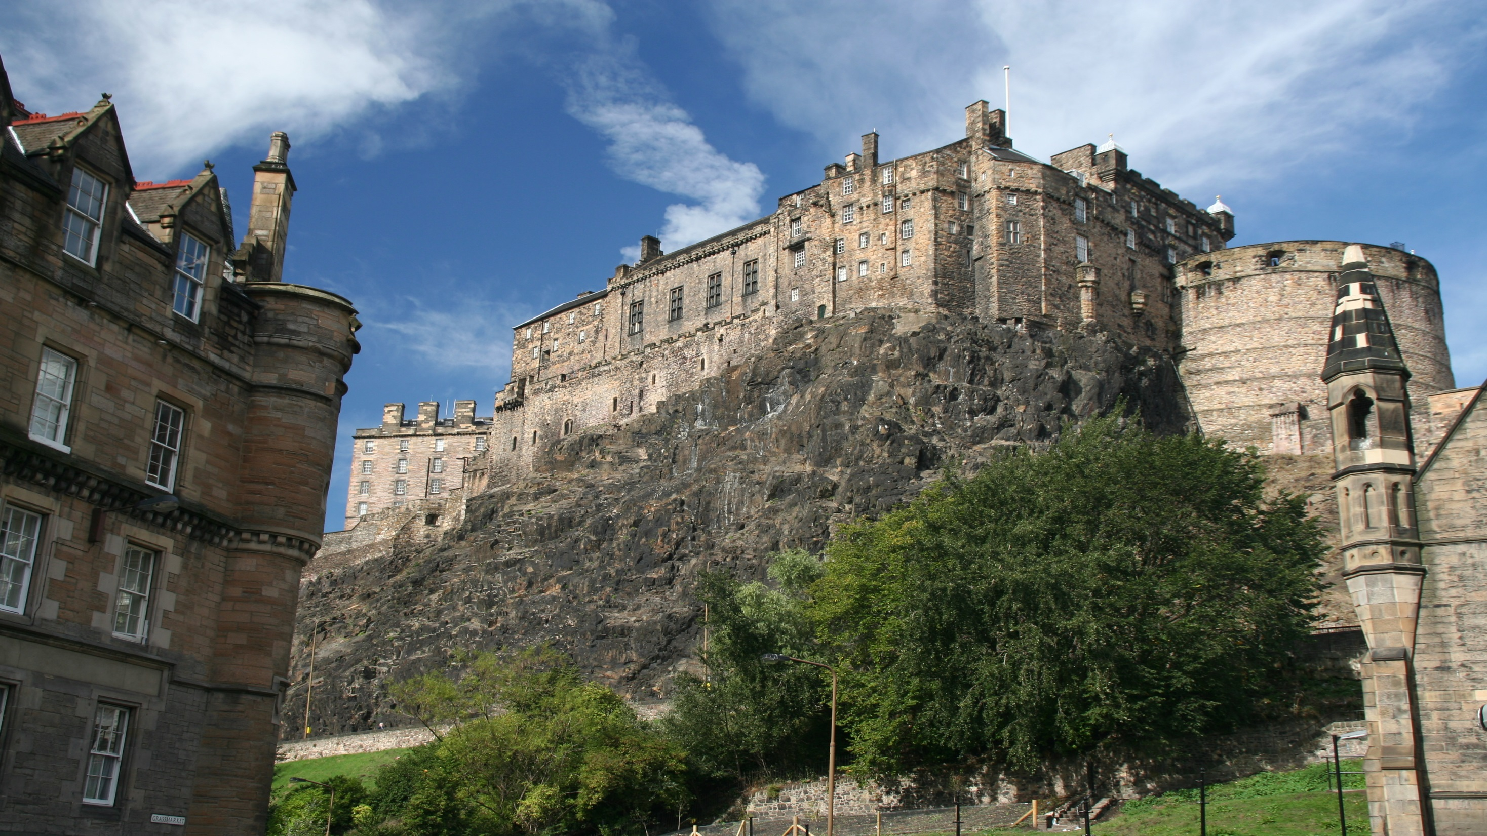
EDINBURGH
CASTLE

Slide 35
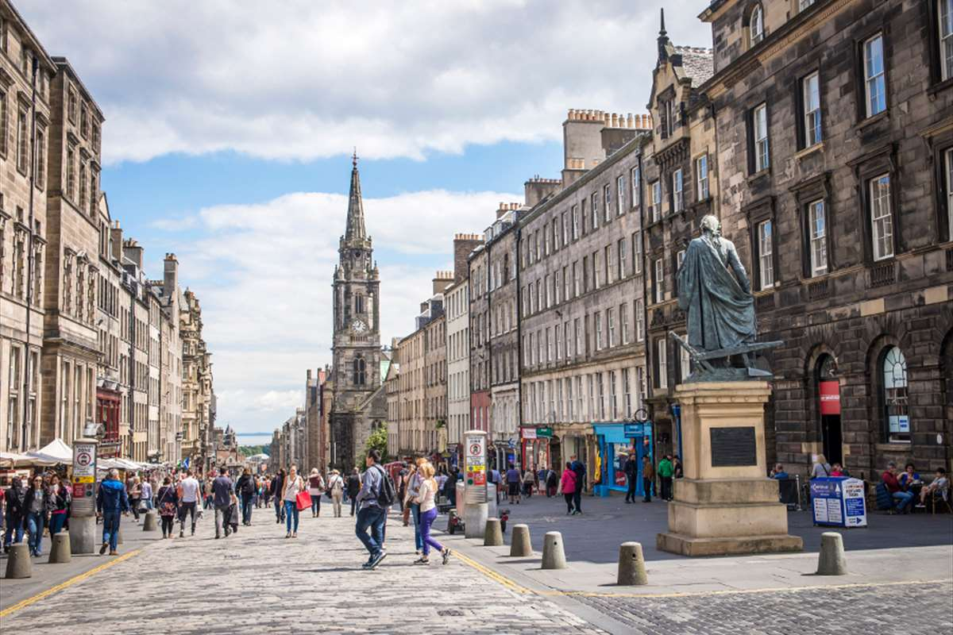
THE ROYAL MILE

Slide 36
THE SCOTTISH HIGHLANDS

Slide 37
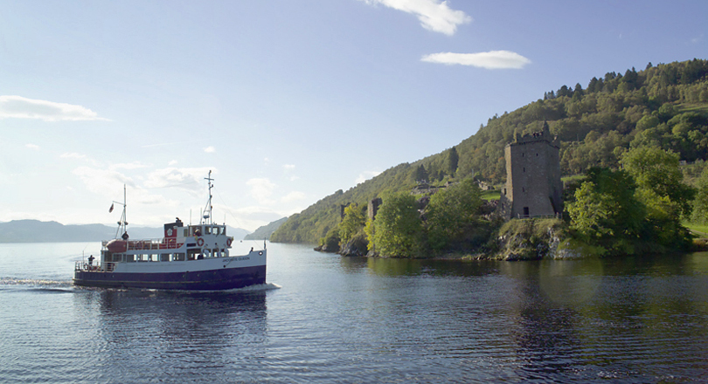
LOCH NESS ADVENTURE

Slide 38
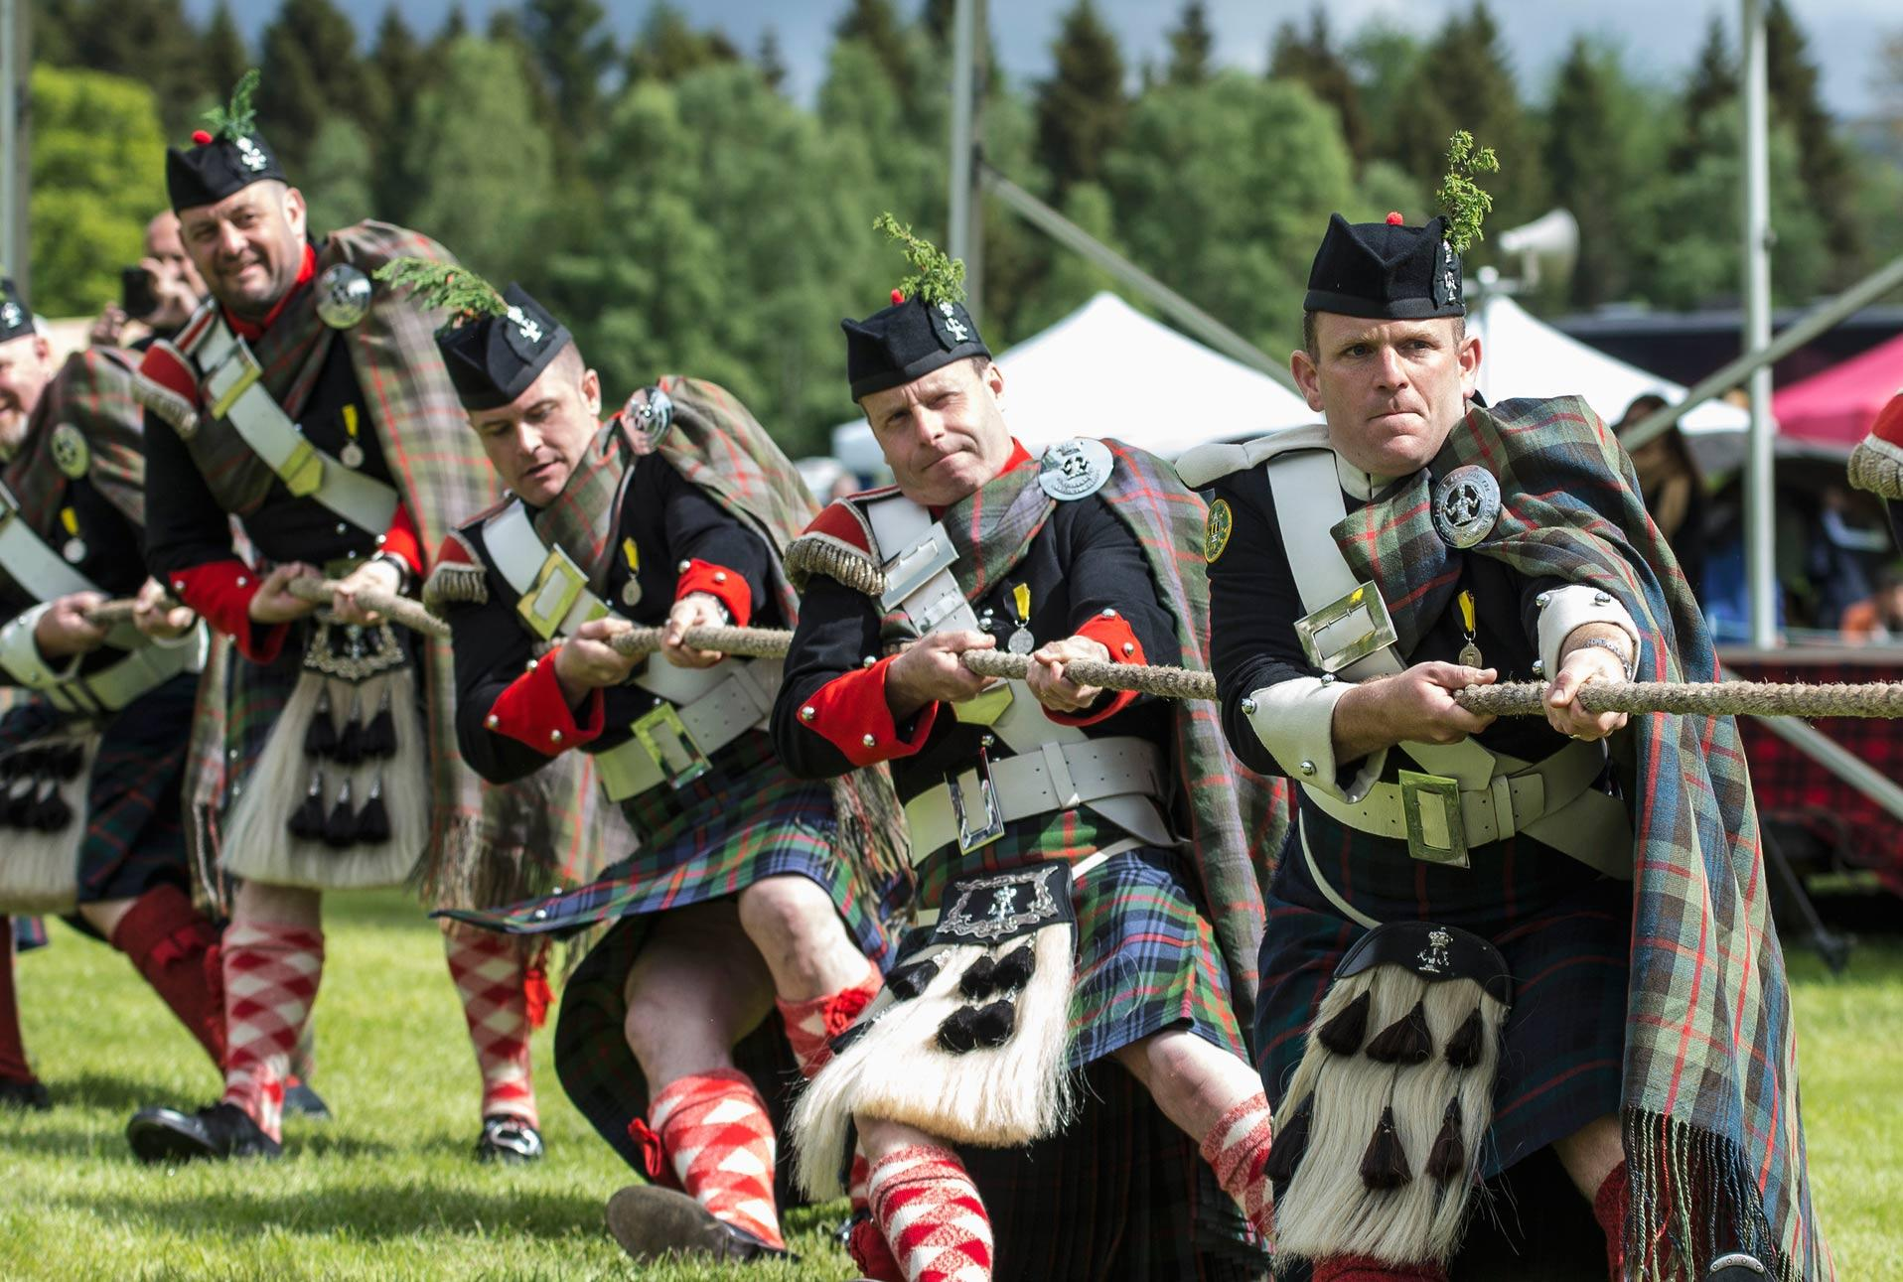
SCOTTISH HIGHLAND GAMES

Slide 39
HIGHLAND GAMES
STONE THROW

Slide 40
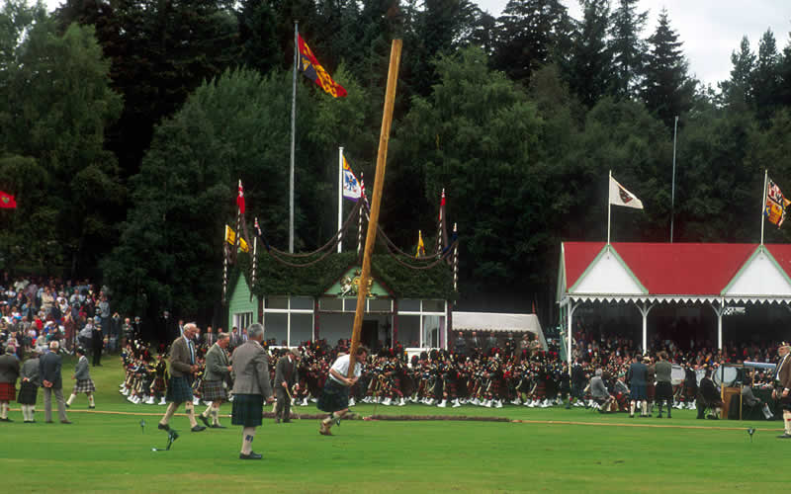
HIGHLAND GAMES
CAPER TOSS

Slide 41
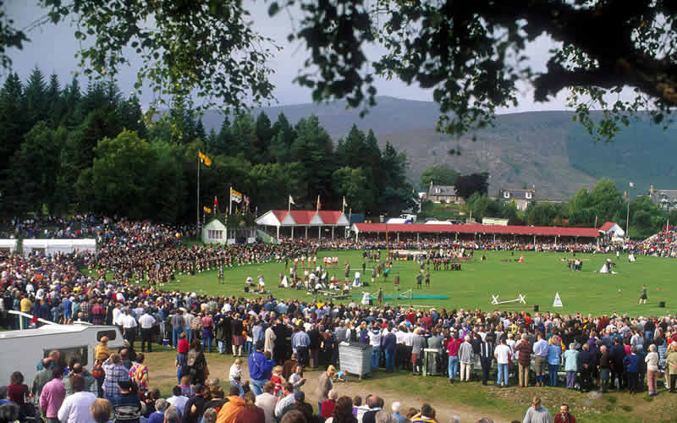
A FULL AFTERNOON AT THE FESTIVAL

Slide 42
OUR GROUP HAS AN OPEN INVITATION TO PARTICIPATE IN THE GAMES.
ANYONE BRAVE ENOUGH TO TRY?

Slide 43
LIVERPOOL

Slide 44
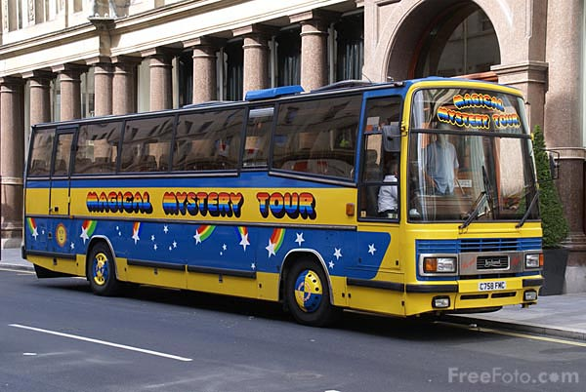
BEATLES MAGICAL MYSTERY TOUR

Slide 45
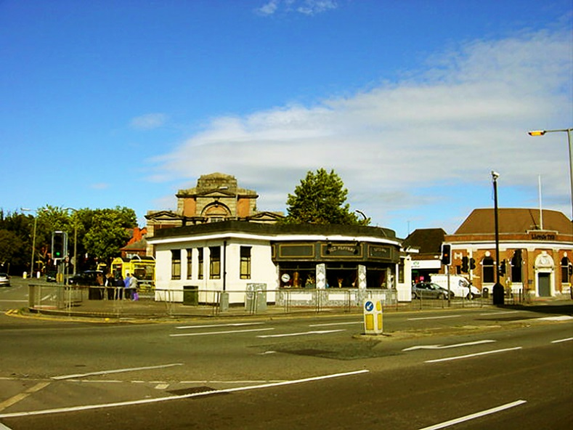
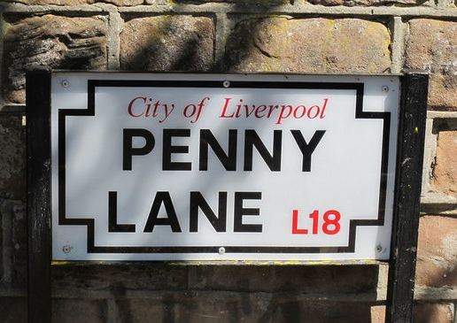
SITES
ON
THE
TOUR

Slide 46
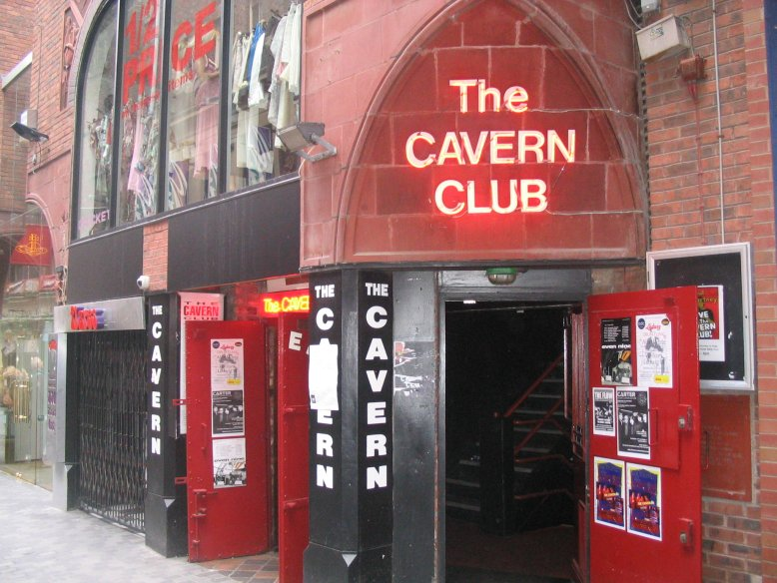
A must stop for any music fan
A MUST STOP FOR ANY MUSIC FAN

Slide 47
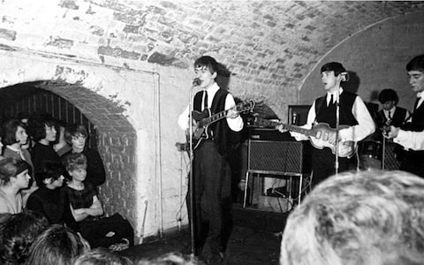
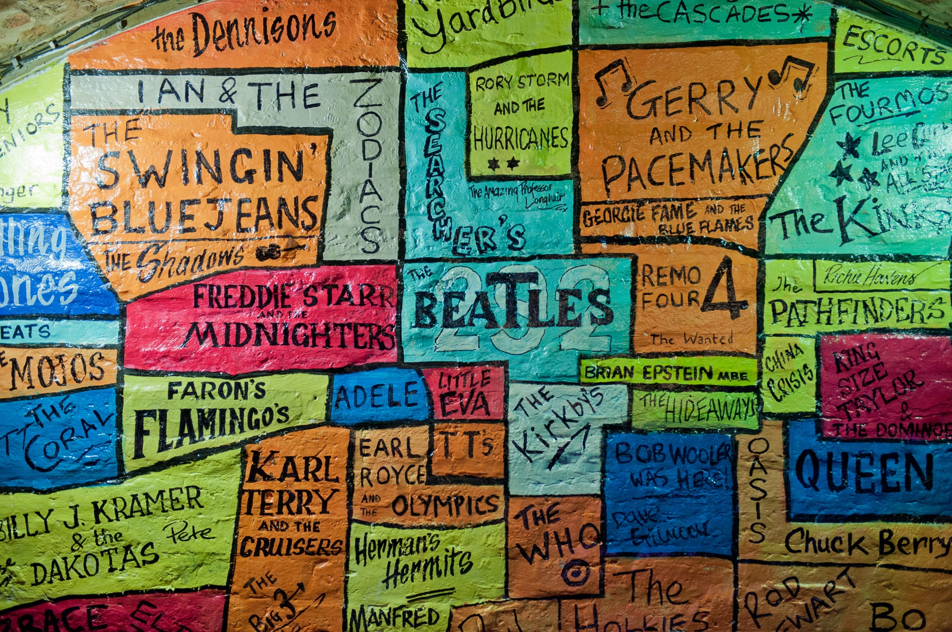
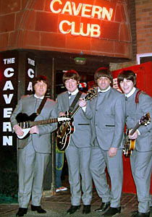
MANY GREAT ROCK AND ROLL ACTS HAVE PLAYED THE CAVERN

Slide 48
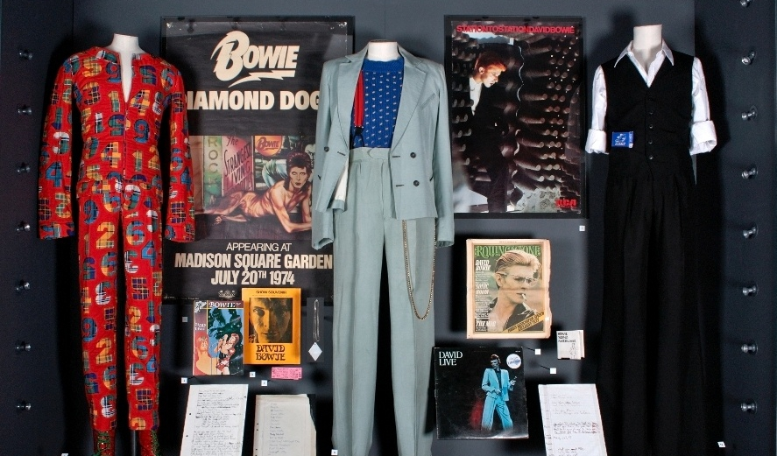
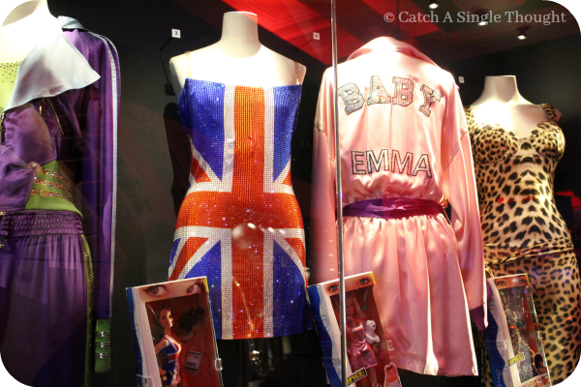
GREAT BRITAIN’S ROCK AND ROLL HALL OF FAME
YOU CAN PLAY THE ACTUAL INSTRUMENTS OF ROCK STARS

Slide 49
WHAT ARE THE COSTS?
TRAVEL AGENCIES TYPICALLY CHARGE OVER $5,500 FOR A 2 WEEK TRIP LIKE THIS AND THEY WILL NOT INCLUDE ALL MEALS
AGENCIES TAKE SIGNIFICANT PROFIT FOR THEIR SERVICES

Slide 50
WHAT ARE THE COSTS?
HOTEL ACCOMMODATIONS $800
TRANSPORTATION WITHIN EUROPE $300
FOOD $700
ITINERARY SITES $800
TRIP INSURANCE $200
CLOTHING AND LUGGAGE $150
TOTAL $2,950

Slide 51
FREQUENTLY ASKED QUESTIONS
WILL THE DISTRICT BE PROVIDING A NURSE?
We will have someone on the trip with medical experience but we do not expect to have a full time nurse on board.

Slide 52
FREQUENTLY ASKED QUESTIONS
HOW WILL MEDICATION BE HANDLED?
As in all overnight trips, staff are permitted to administer medication after taking an approved on-line course for certification
It is recommended that due to the nature of this trip, students who have multiple medications or have medication that has side effects, should be accompanied by a parent

Slide 53
FREQUENTLY ASKED QUESTIONS
HOW WILL ILLNESS ON THE TRIP BE HANDLED?
We can take your child to get medical attention. Additional costs for such care would be borne by the parent. A consent for treatment contract would be required. Trip insurance would cover some medical expenses, but we ask parents to carefully review the trip insurance policy at decision time.

Slide 54
FREQUENTLY ASKED QUESTIONS
HOW WILL CONDUCT ON THE TRIP BE HANDLED?
A student’s conduct will be thoroughly screened prior to the trip to assure that they have demonstrated a willingness to cooperate with adults in charge.
A student removed from the trip due to behavior will be returned at parent expense.

Slide 55
FREQUENTLY ASKED QUESTIONS
CAN FAMILY MEMBERS ATTEND?
Yes, however, we are discouraging children who are very young. This trip is no place for a very young child even when accompanied by a parent.
One all students have had a chance to register the trip will be open to family members

Slide 56
FREQUENTLY ASKED QUESTIONS
IS THERE A PAYMENT PLAN?
Absolutely. A payment/installment schedule will be worked out to make sure that money is collected only when it is needed for deposits or front-ended items like tickets, transportation and the like.

Slide 57
FREQUENTLY ASKED QUESTIONS
WHAT ABOUT AIRFARE?
Airlines are allowed to sell routes up to 330 days prior to the departure. We will buy into the plane early as the seats are cheaper as the plane fills.
Separate insurance will be purchased through the airlines so parents must read the fine print as far as refunds, changes or re-ticketing is concerned.

Slide 58
FREQUENTLY ASKED QUESTIONS
WHAT IF I CHANGE MY MIND?
Like all other overnight trip run here, this is a zero-sum finance system. If money is already spent, we will not surcharge other parents and students in order to provide a refund. Money that has not been spent can be recovered and refunded.
If, however, we can replace someone who drops, a full refund will be issued.

Slide 59
FREQUENTLY ASKED QUESTIONS
WHAT IF YOU DID NOT ANSWER MY QUESTION?
No Problem.
We will get you an answer.
You can email me or call me at the school and I will get you the information you need to make a decision.

